Slide 1
Multiple Traffic Signal Control Using a Genetic Algorithm
T. Kalganova, G.Russell, A. Cumming
Proc. of the Fourth International Conference on Artificial Neural Networks and Genetic Algorithms (ICANNGA'99). Portoroz, Slovenia. pp. 220-228. (1999)
Presenter： Shiuan-Wen Chen
Date： Aug. 16, 2006

Slide 2
Abstract
Optimising traffic signal timings for a multiple-junction road network is a difficult but important problem. The essential difficulty of this problem is that the traffic signals need to coordinate their behaviours to achieve the common goal of optimising overall network delay. This paper discusses a novel approach towards the generation of optimal signalling strategies, based on the use of a genetic algorithm (GA). This GA optimises the set of signal timings for all junctions in network. The different efficient red and green times for all the signals are determined by genetic algorithm as well as the offset time for each junction.

Slide 3
Abstract
Previous attempts to do this rely on a fixed cycle time, whereas the algorithm described here attempts to optimise cycle time for each junction as well as proportion of green times. The fitness function is a measure of the overall delay of the network. The resulting optimised signalling strategies were compared against a well-known civil engineering technique, and conclusions drawn.

Slide 4
1. Introduction
This paper presents a traffic control method based on GAs. The goal of the author’s investigations was to generate near optimal traffic signal settings for each traffic controller in terms of minimal delay of an entire road network.
The idea of this approach can be briefly described as follows:
  1. Traffic signal timings are generated by a GA for the entire network.

Slide 5
1. Introduction
  2. A high-speed traffic simulator simulated the network using the traffic signal timings generated from the GA.
  3. The simulator produced a fitness measure for the signal settings, and this was fed back into the GA.
This list was iterated over until the GA was stopped, which occurred either when a execution-duration maximum or an apparent fitness maximum was reached.

Slide 6
2 A Genetic Algorithm For Traffic Signal Control
The objective in adjusting the timing of traffic control signals is to minimise the overall delay to traffic over an entire traffic network [5].
The GA described in this paper tackles the problem of obtaining good signal timings by evolving the signal proportions, offsets and the cycle time.
  The offset time is the difference between an absolute zero clock and the clock that turns the first of the signals in a junction to green.
  (Each junction has an offset time)

Slide 7
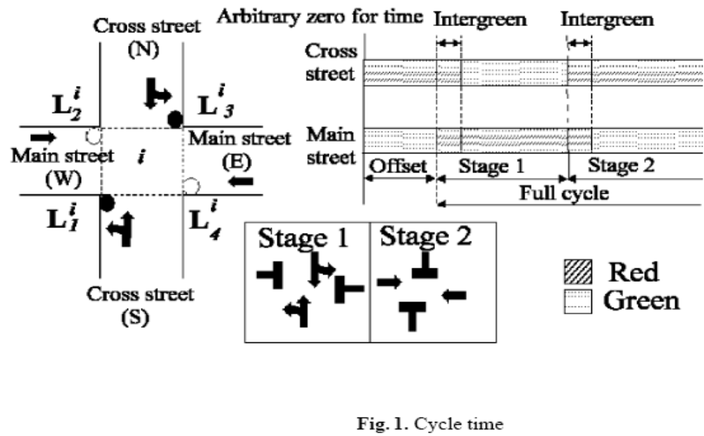

Slide 8
2.1 Traffic Signal Parameters
the inter-green period (IGP)
  In Britain, IGP =3seconds.
the green and red time for a particular approach, t_{g} and t_{r} respectively;
the cycle time for a particular junction, t_{c}= t_{r} + t_{g};
the offset time, t_{o};

Slide 9
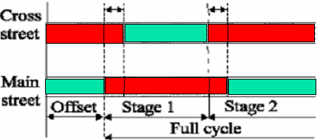
2.2 Chromosome Representation
Chromosome C describes the behaviour of n traffic controllers which is represented by C, where C=<C₁, C₂, ...,C_{n}>.
Each C_{i}=<b^{i} c₁^{i} c₂^{i} c₃^{i}>, i=1, ..., n defines all the parameters needed by the i-th controller.
b^{i} is referred to as the first colour of the signal, and has a duration (c₁^{i} + c₃^{i}). c₂^{i} is the duration of the second colour, which is the opposite colour to that of the first colour.

Slide 10
2.2 Chromosome Representation
Based on this type of chromosome representation we can compute the cycle time for the i-th junction and offset time as follows:
  t_{o}= c₁^{i} and t_{c} = c₁^{i} + c₂^{i} + c₃^{i} +2*IGP
If gene b^{i} indicates that the first colour is green, then Main Street is:
  t_{g}= c₁^{i} + c₃^{i} and t_{r}= c₂^{i} +2*IGP
otherwise:
  t_{r}= c₁^{i} + c₃^{i} +2*IGP and t_{g}= c₂^{i}
Cross Street t_{g} is simply Main Street t_{r}-2*(IGP)

Slide 11
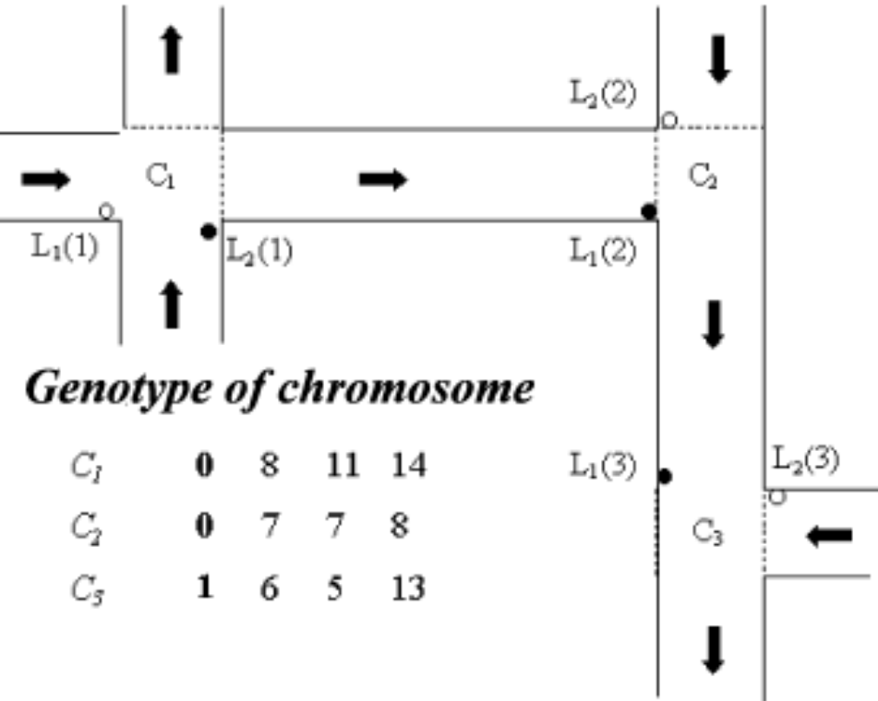
2.4 Multiple-Junction Network Representation
Consider the three-junction road network shown in Figure 2. In this case the chromosome contains <C₁;C₂;C₃>, as the network has three junctions.

Slide 12
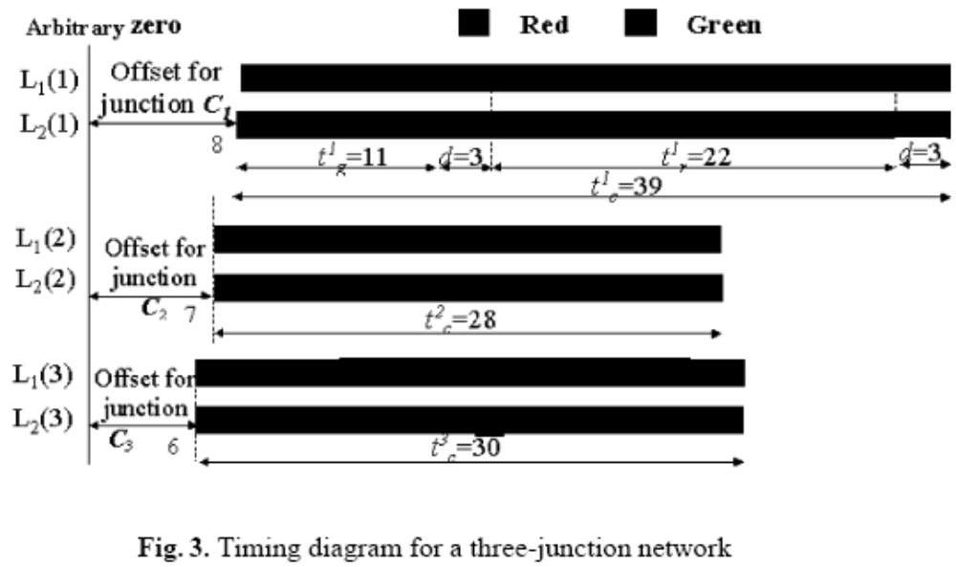
2.4 Multiple-Junction Network Representation

Slide 13
2.5 Preparation Of String Encoded Parameters
A set of randomly initialised parameters b^{ij},c₁^{ij},c₂^{ij}andc₃^{ij}, i=1, ..., n; j=1,..., m is prepared such that c₁^{ij}+c₂^{ij} +c₃^{ij} + 2*IGP ≦ 130, where m is the number of chromosomes in population.
The gene b_{ij} defining the start signal for L1(i)traffic light is randomly initialised and takes value 0 or 1. c_{k}^{ij} is randomly initialised in the range [0, 130], where k=1,2,3.

Slide 14
2.7 The Genetic Search Operators
Evolution of the population in the GA involves two basic steps: (1) a selection mechanism that implements a survival of the fittest strategy and (2) a genetic recombination of the selected chromosomes to produce offspring for the new population.
Recombination is affected through the two genetic operators of crossover and mutation.

Slide 15
2.7 The Genetic Search Operators
In order to obtain the highest convergence within the GA different types of selection and crossover were investigated, as well as different sizes of population.
Two types of selection operators were used: roulette wheel and probabilistic binary tournament.
This experimentation also indicated that tournament selection significantly outperformed roulette wheel.
Three different types of crossoverwere implemented:
  (1) uniform, (2) one-point and (3) two-point.

Slide 16
3 Experimental Results
An experiment was constructed where the GA controlled the settings of the three simulated signalised junctions
we have used a urban traffic simulator, JUDGE [6], which was developed by the authors during research performed a few years ago at Strathclyde University.
The GA produced traffic signalling information,which is then simulated by JUDGE for 16 minutes of traffic time

Slide 17

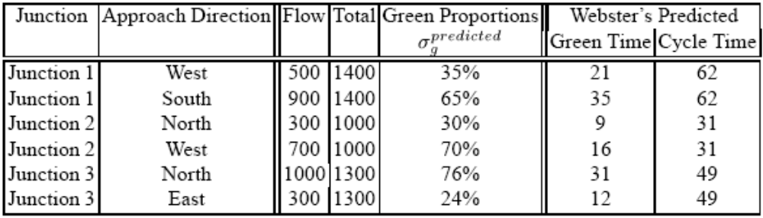
3 Experimental Results
Flows are measured in pcu/hr.
A pcu, or Passenger Car Unit is a number which describes how big a vehicle is. A bicycle is 0.3 pcu, whereas the standard household vehicle is 1.0 pcu.

Slide 18

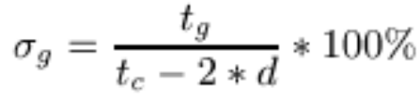
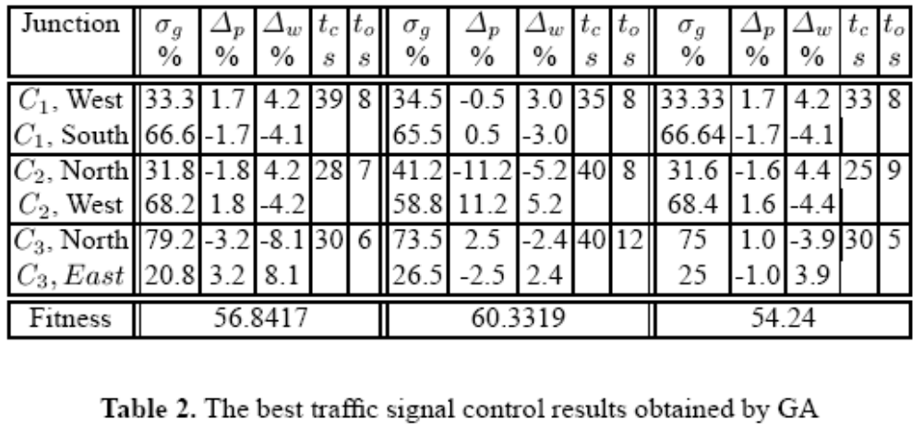
3 Experimental Results

